Slide 1

Introducing the Wellness Project
Raising Healthy Families
Performance Fitness with Olympic mentors
Aging gracefully at all stages of life

Slide 2
Thanks to Moderators
Scott Palmer & Carolyn Wightman
With wonderful team of local supporters
Please ask…
…if you would like to review this material again, or if you feel it would be of value to additional audiences

Slide 3


Health & Wellness
Thanks to our hosts
Wanda Garcia,
Health & Wellness Nurse Coach
Dr. Mario Garcia,
Brain Health Coach

Slide 4

What is Wellness?
Living your life consciously in ways that improve your health and well being.

Slide 5
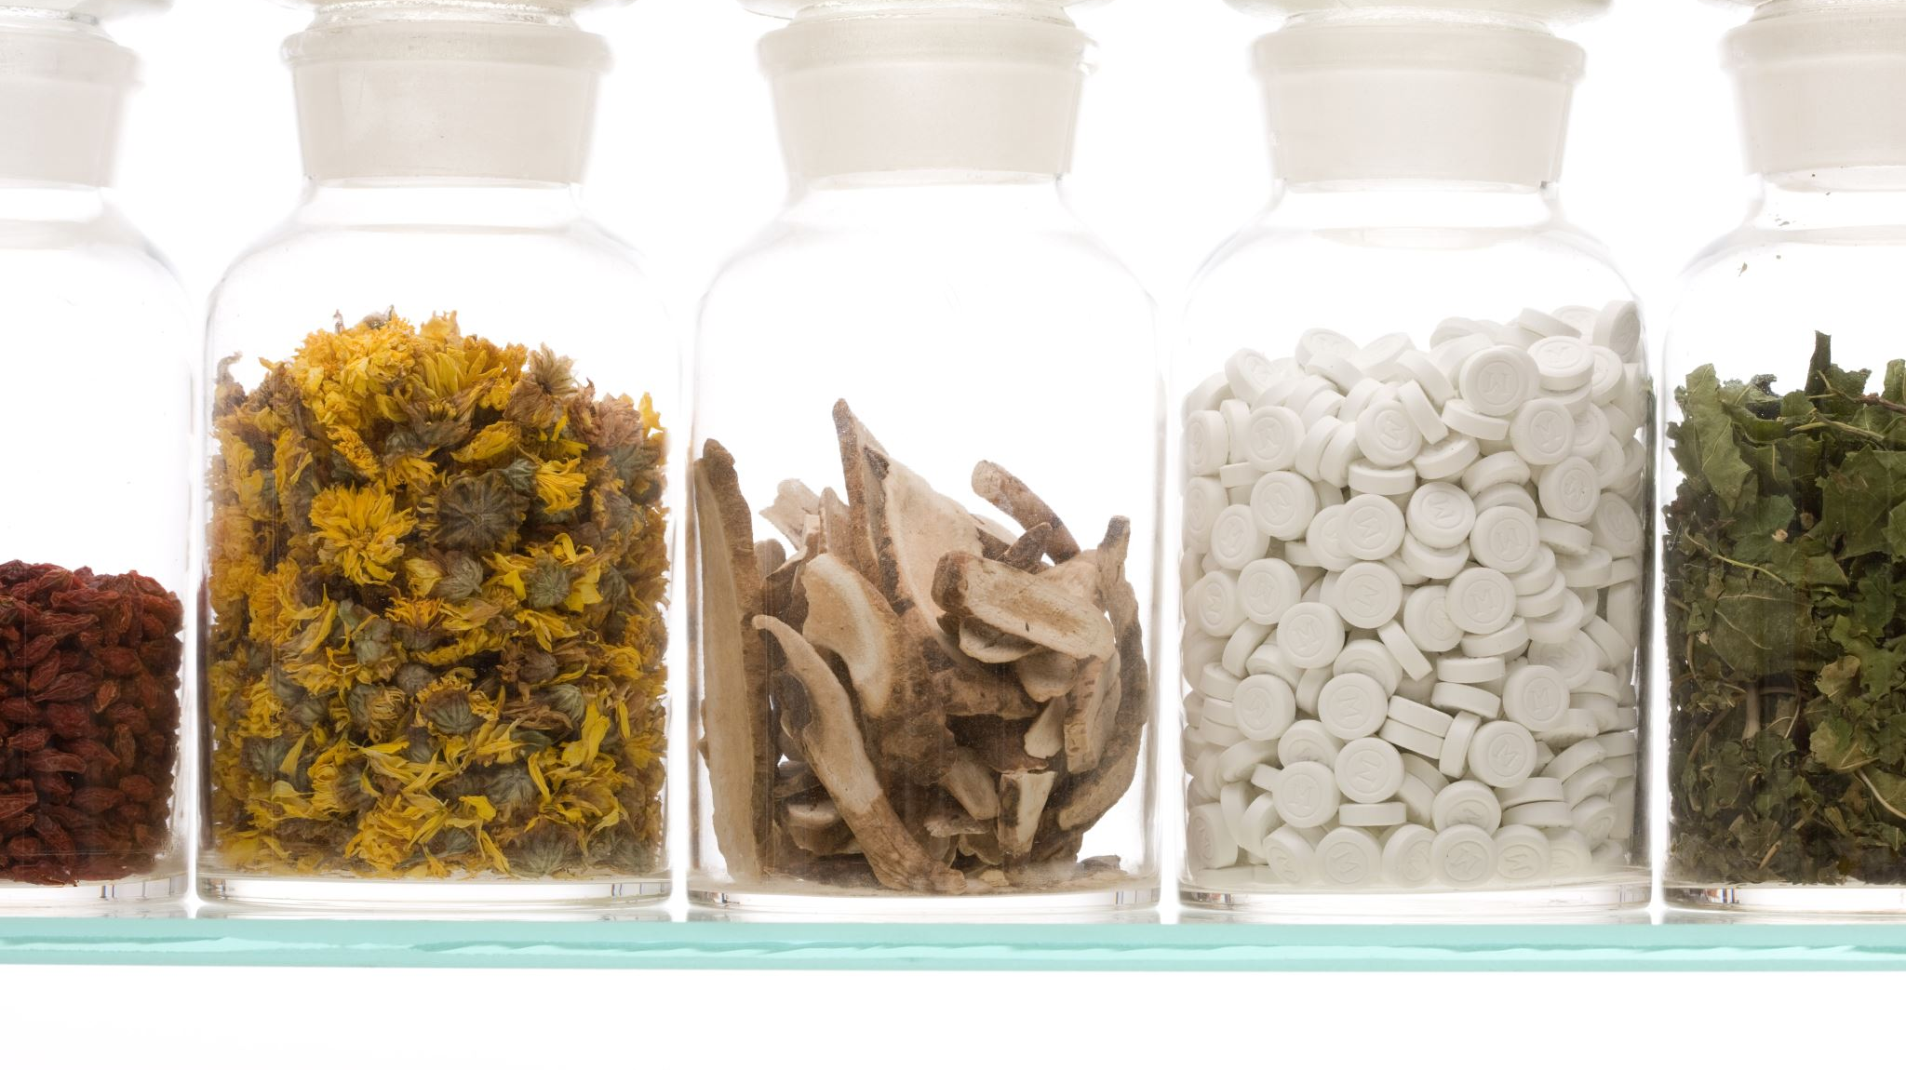
Health & Wellness Strategies

Slide 6
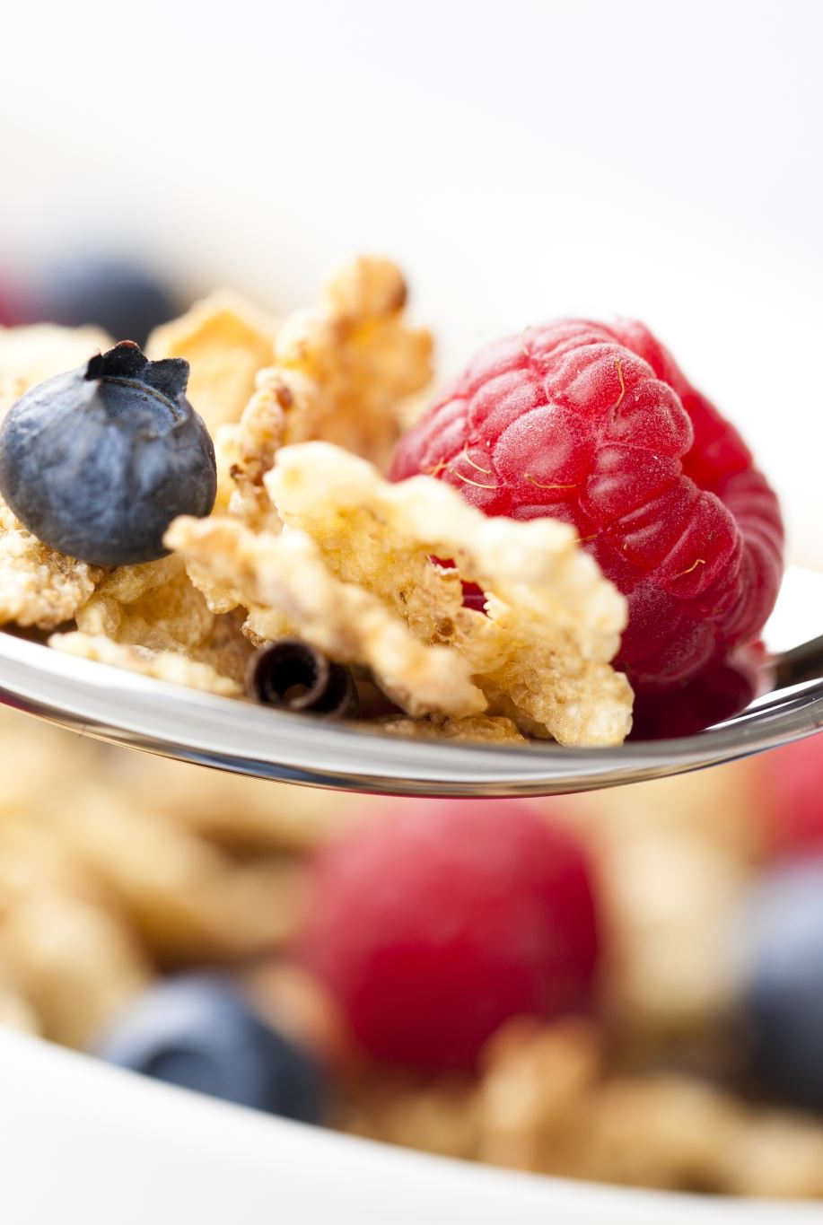
Why is it important to care about Health & Wellness?
Approximately 50% of the US population has a chronic disease, creating an epidemic.
86% of health care costs are attributable to chronic disease (Holman, 2020).
Changing behavior in regard to health habits is difficult and complex, and people don’t really understand the change process (Prochaska & Prochaska, 2016).
Many people struggle with poor health and vitality because they lack the motivation, skills, knowledge and resources to make sustained changes in lifestyle habits.

Slide 7
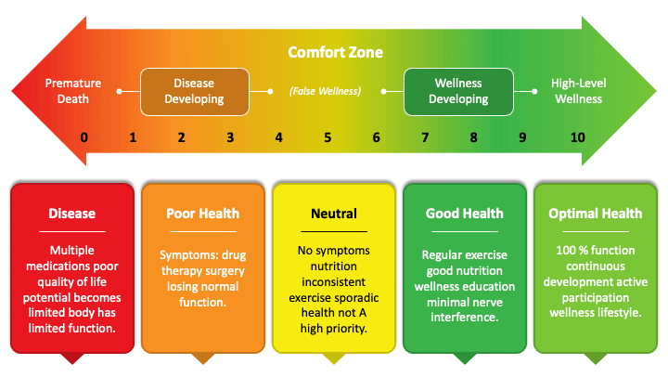
Where are you this Continuum

Slide 8
Let’s look at this more carefully.

Slide 9

Strategies for Health & Wellness
Five lifestyle factors have been shown to reduce risk for type 2 diabetes:
1) having a healthy diet & environment
2) keeping an ideal body weight
3) being physically active
4) not smoking
5) minimizing alcohol use.

Slide 10
Strategies for Health & Wellness
Five lifestyle factors have been shown to reduce risk for type 2 diabetes:
Men who adopted all 5 healthy lifestyle factors lower their risk for developing diabetes by 72%:
Women who adopted all 5 healthy lifestyle factors lower their risk for developing diabetes by, by 84%. (Reis, 2011).

Slide 11

Problem #1 : We are NOT eating right!

Slide 12
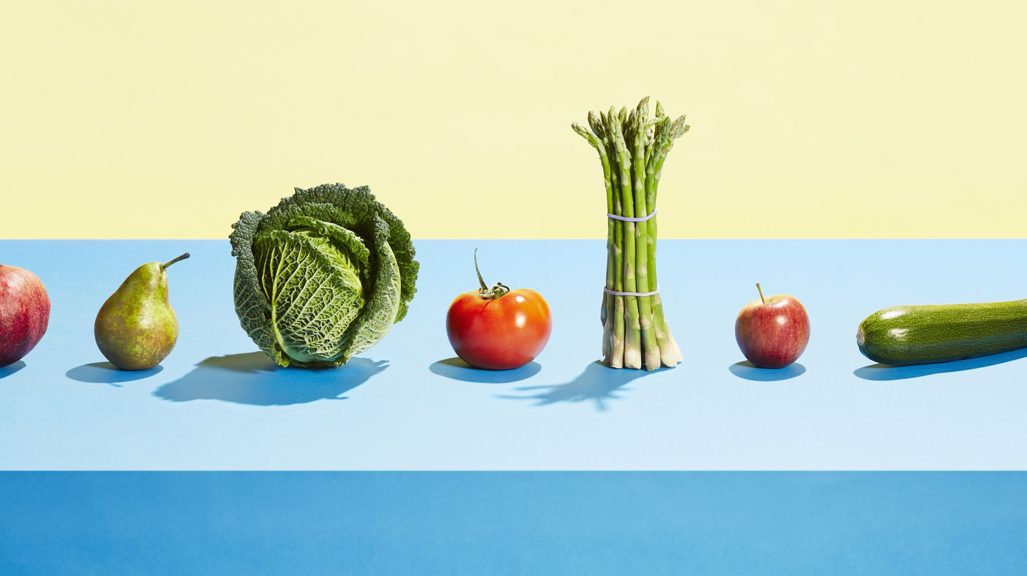
Problem #2
Even “healthy” food is not as nutritious as it once was!

Slide 13
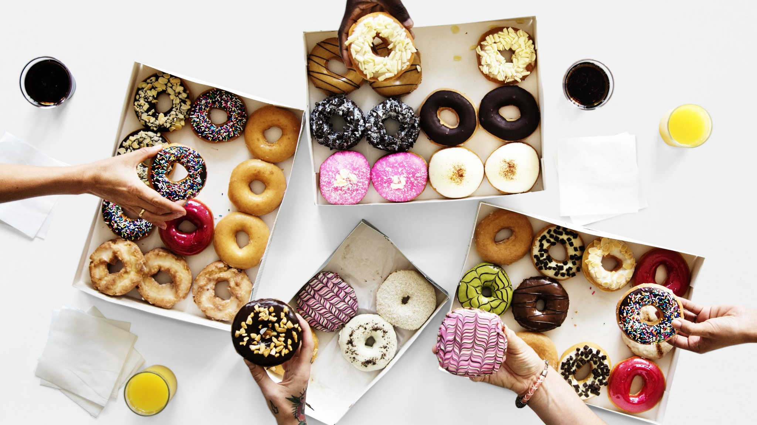
Question:
Does commercialism contribute to the poor quality of our food?
Maybe craving for sweets?

Slide 14

Impacts of commercialism on our foods?
Yes, 90% of our people are dependent upon commercial interests for their food supply.
The farmer is eager to grow two ears of corn in place of one, so he uses chemical “fertilizers.”
The effect of such chemicals may reduce the nutritional value of those two ears far below the value of one ear grown on organically fertilized soil, but the two ears bring a higher price.
And so it is with all food processors, almost without exception.
Profit determines the method of preparation.

Slide 15

Problem #3:
We are less active, so we need fewer calories!

Slide 16
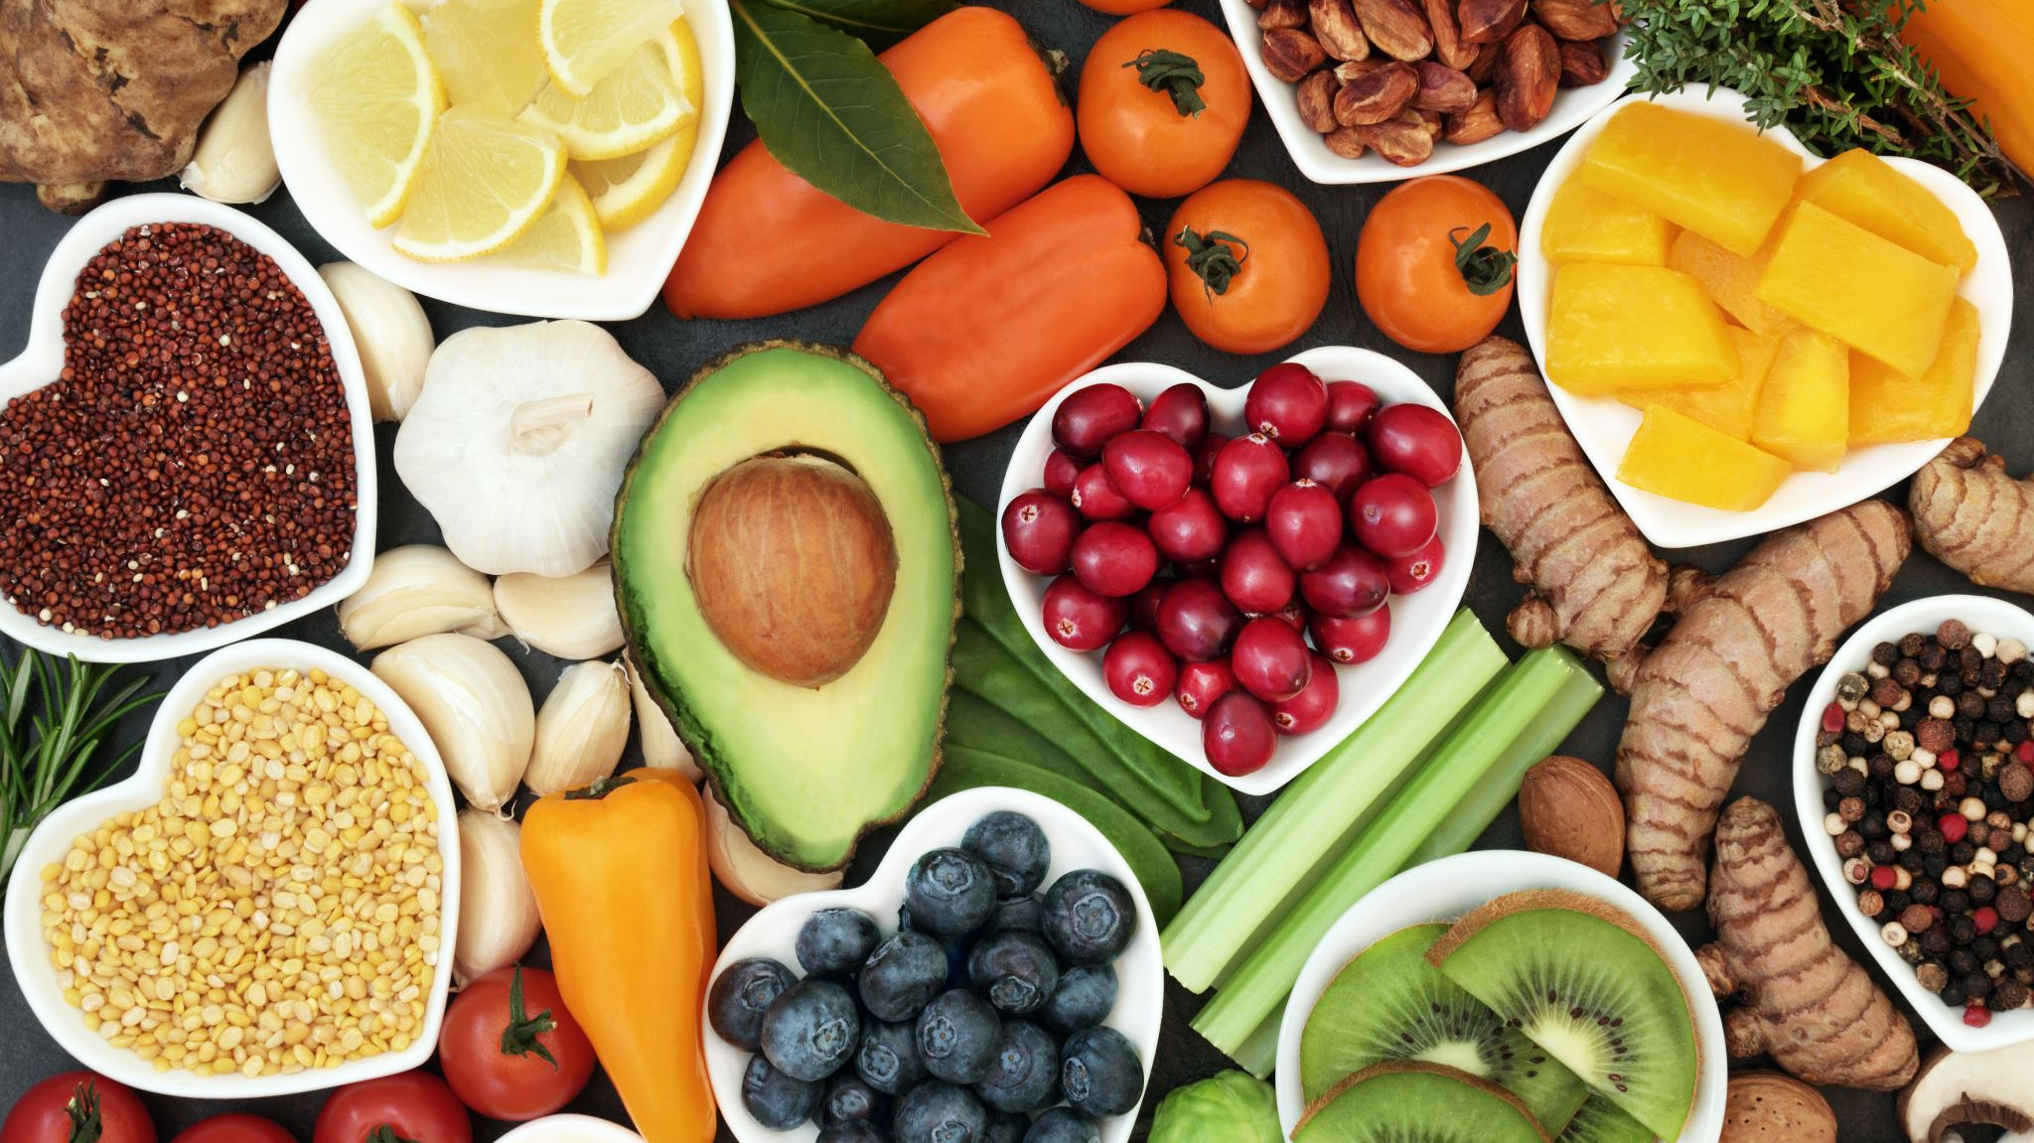
Sedentary Lifestyles:
All of the nutrients we need must therefore come from fewer calories.

Slide 17

Problem #4: Contamination of Food Supply
Many changes in late 1980’s
are impacting current generations

Slide 18

Result #1: OBESITY
INCREASING GLOBALLY
INCREASE THE RISK OF ABOUT 80 MEDICAL CONDITIONS

Slide 19
Result #2: Toxins Inside Us
Heavy Metals
Pesticides
Industrial Chemicals
Pathogens

Slide 20
Lasting Lifestyle Changes

Slide 21

Result #3: Need for better “Wellness Education.”
Encourage / Support better diet plans
Encourage Supplementation
Support Cleaner Agriculture Practices
Educate Healthcare Professionals

Slide 22


Result #3: Need for better “Wellness Education.”
What if…
We depended on our MD’s & Rx when we were sick …
… and we could be even better educated to not need them so much…
Encourage / Support better diet plans
Encourage Supplementation
Support Cleaner Agriculture Practices
Educate Healthcare Professionals

Slide 23
Our default resource is to ask the MD.
They are educated to treat, not to prevent
Any other choices?
Chiropractor
Massage therapist
Acupuncture
Non-Western medicine
Other

Slide 24
Some Simple Steps to Start
Check for Food Ingredients
Water
not sodas
Create a Non-toxic Home
Laundry & Fragrances
Only safe ingredients on the skin

Slide 26
Where to Start?
Living your life consciously in ways that improve your health and well being.
Start at home
Check for the sugars
Move!
Try to decipher labels
Find healthy partners

Slide 27
People say this is what’s important to them
Choices that are SAFE
Choices that are PROVEN

Slide 28
What we know about our Customers
They’re SMART.
They like to do their homework.
They’re BUSY.
Too much internet surfing or label reading can lead to paralysis.
Once they find things that meet their standards, they can become lifetime customers.

Slide 29
Invitation
If this sounds like you,
and you’d like to know what we have found that checks all of these boxes, reach out and we’re happy to talk with you privately.

