Slide 1


WELCOME
TO
YOUR DREAM LIFE

Slide 2
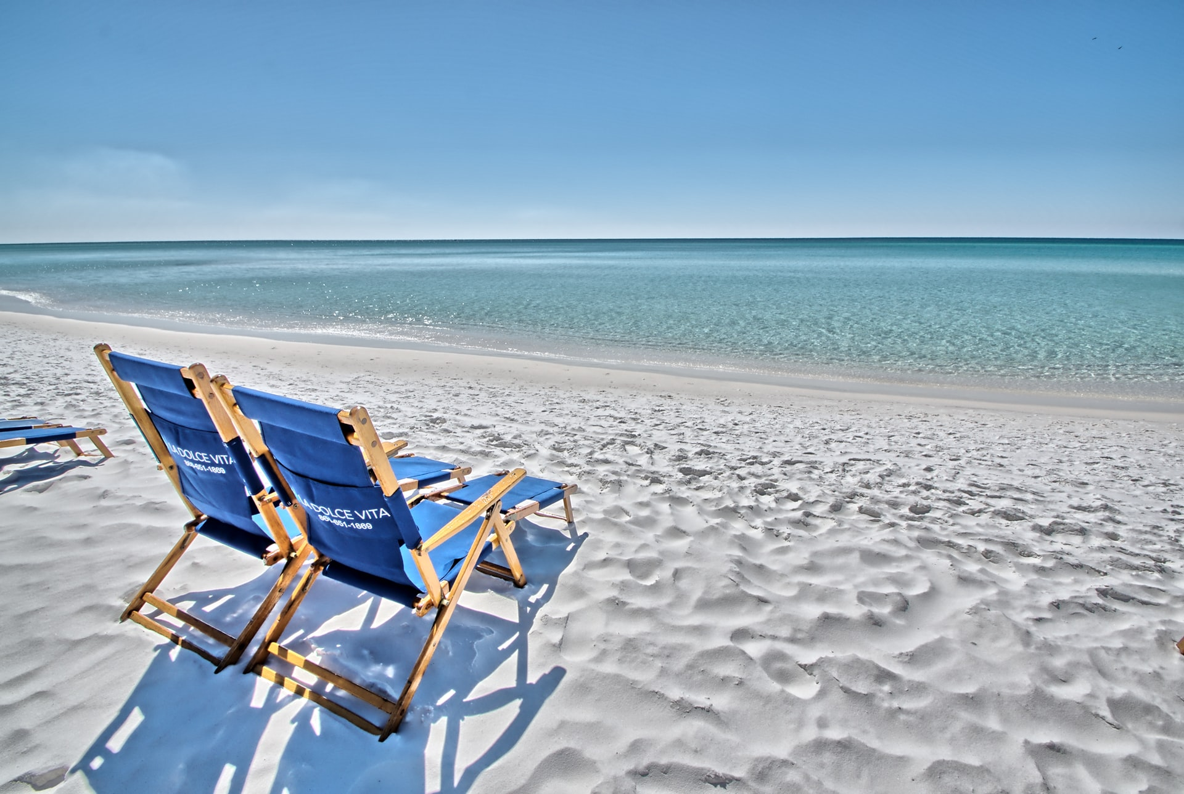
What do you really want for your life?

Slide 3

What would it be like to have all the
Money you need and then some ?

Slide 4



What if you could Work From Home …
or From Anywhere?

Slide 5

What would it be like to live in your
Dream Home?

Slide 6

X
X
X
What would it be like to drive your Dream Car?

Slide 7

IF IT WERE FREE …
Where would you go for your dream vacation?

Slide 8


What would it be like to Feel Younger …
Longer?

Slide 9

Life is a matter of Choice
Get a Degree - Get a Good Job
Teacher - $48,000
Registered Nurse - $52,000
Software Engineer - $98,500
Attorney - $144,000
Surgeon - $267,000
However
There is an earning ceiling
You can’t pass it on to your
spouse or the next generation

Slide 10
Life is a matter of Choice
Start Your Own Business
15 Million Americans are full-time self-employed
26% say biggest motivator is to be their own boss
U.S. is the best country for entrepreneurs (GEI of 86.6)
Only 9% of entrepreneurs have a degree in business
60% of small businesses without paid
employees are home based.
However
Huge capital investment
45% fail in the first 10 years
Only 25% make it to 15+ years

Slide 11

NETWORK MARKETING/SOCIAL MARKETING
is the solution to achieve FINANCIAL FREEDOM
World’s Fastest Growing Industry
You have full control to create your dream lifestyle
Team Effort (Leverage)
Earning Passive Income
Notes:
11

Slide 12

Choose the Right Company

Slide 13
Finding the RIGHT BRAND PARTNER involves answering YES to FOUR KEY QUESTIONS
Is the COMPANY and its philosophy sound?
Does the company’s compensation plan provide the
OPPORTUNITY you want?
3. Do the company’s PRODUCTS meet a real need, and do they work?
4. Will you be able to join a team that provides the LEADERSHIP you will need to succeed?
And if the answer to the first four is “Yes,” then…
Can you SEE YOURSELF DOING what is required to succeed?

Slide 14

Shaklee was one of the first network marketing companies in the world. Founded in 1956.

Slide 15
Perfect Combination Factors
COMPANY
Philosophy of
Dr. Shaklee’s Legacy, Roger’s Global Vision
PRODUCTS
>100 Years
of Innovation
YOU
OPPORTUNITY
The Land of “AND”
( Prosperity )
LEADERSHIP
Team Vision, Mission, Culture, and System

Slide 16

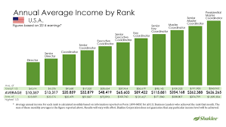

1. The Perfect COMPANY
COMPANY – Living in Harmony with Nature
BUSINESS - In Harmony with the Golden Rule
PRODUCTS – In Harmony with Nature and Good Health

Slide 17
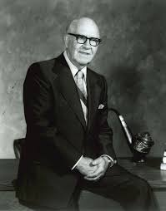


Shaklee’s FOUNDER
Dr. Forrest C. Shaklee - 1894-1985
1894 - Born with tuberculosis
1912 - Became a doctor
1915 - Formulated the 1st Multi-vitamin in the world (Vitalized Minerals)
1956 - Shaklee Corporation was formed

Slide 18
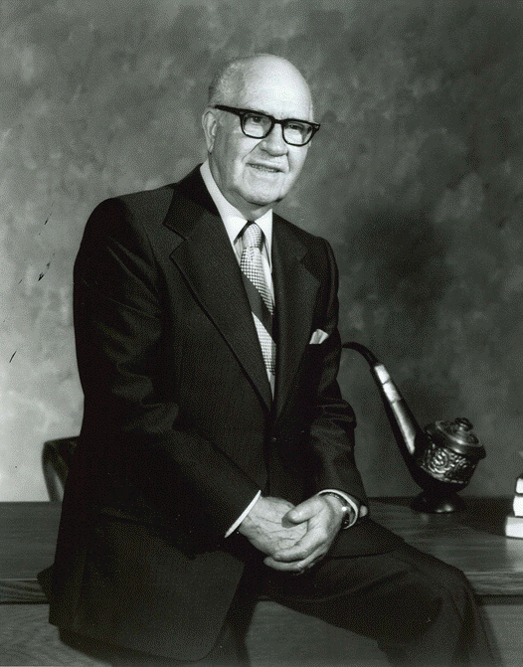
Mission and Vision
“I wanted a company that would improve the lives of everyone it touched ”
“Sow the seeds of happiness in others and you reap a joyful harvest.”
Dr. Shaklee
Founder of the Shaklee Corporation

Slide 19
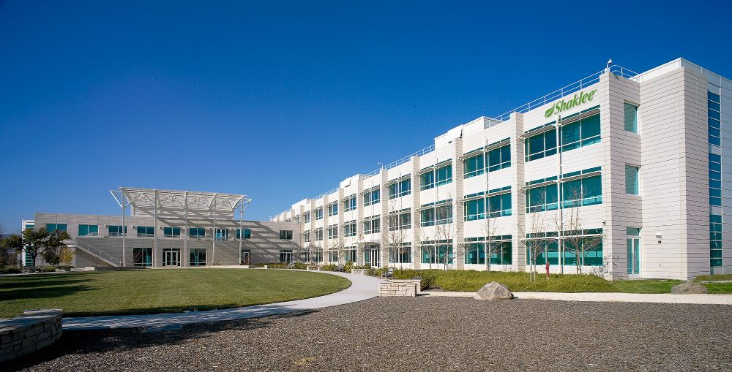
Shaklee’s FOUNDATION For Success
Shaklee is the No. 1 natural nutrition company in the world. With over 64 years of
bullet-proof history, it’s philosophy
and integrity have made it the
gold standard of the
industry.

Slide 20
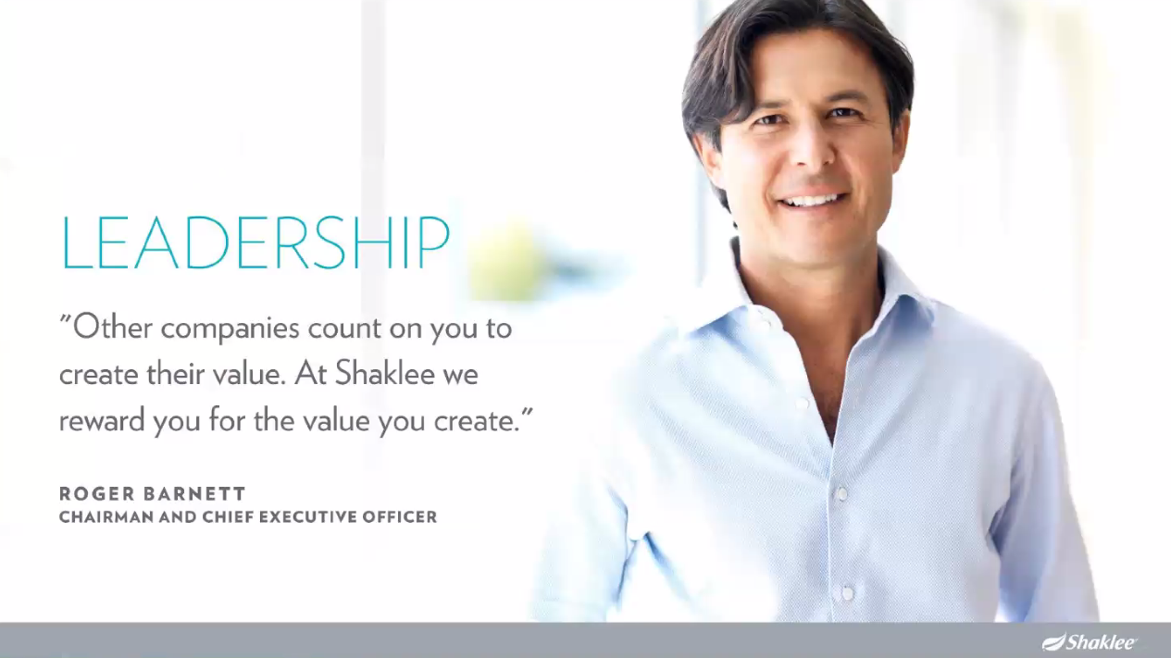
Shaklee’s FUTURE is Assured

Slide 21
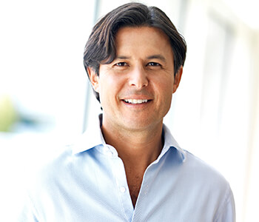
Mission and Vision
“We will be the strongest force on the planet for POSITIVE CHANGE when we have … 10 million members in the Shaklee family.”
Roger Barnett
Owner, Chairman, and CEO
Shaklee Corporation

Slide 22


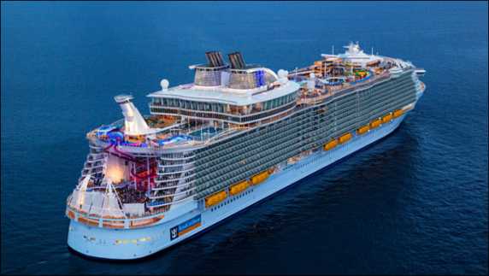


Shaklee the Land of “AND”
2. The Perfect OPPORTUNITY
You can have it ALL

Slide 23
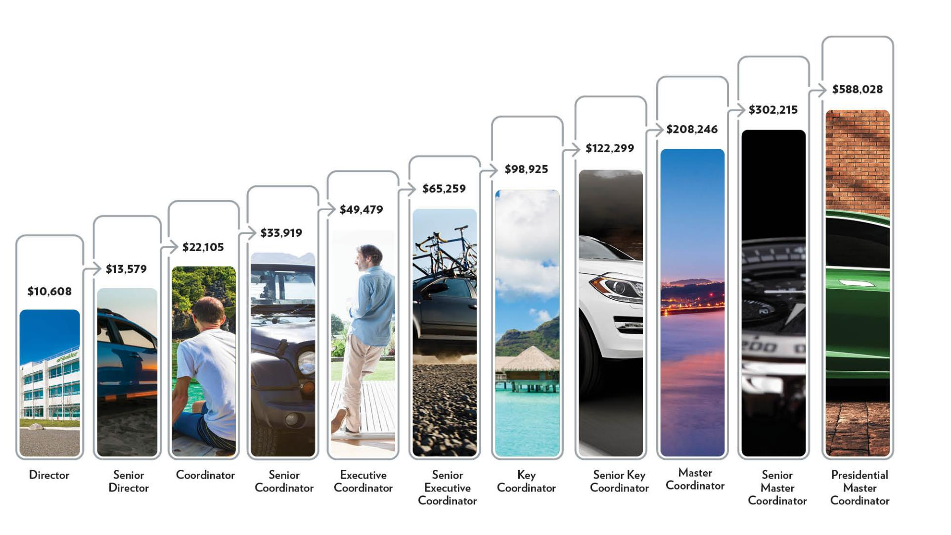
The Perfect Compensation PLAN
Possibilities with Shaklee

Slide 24
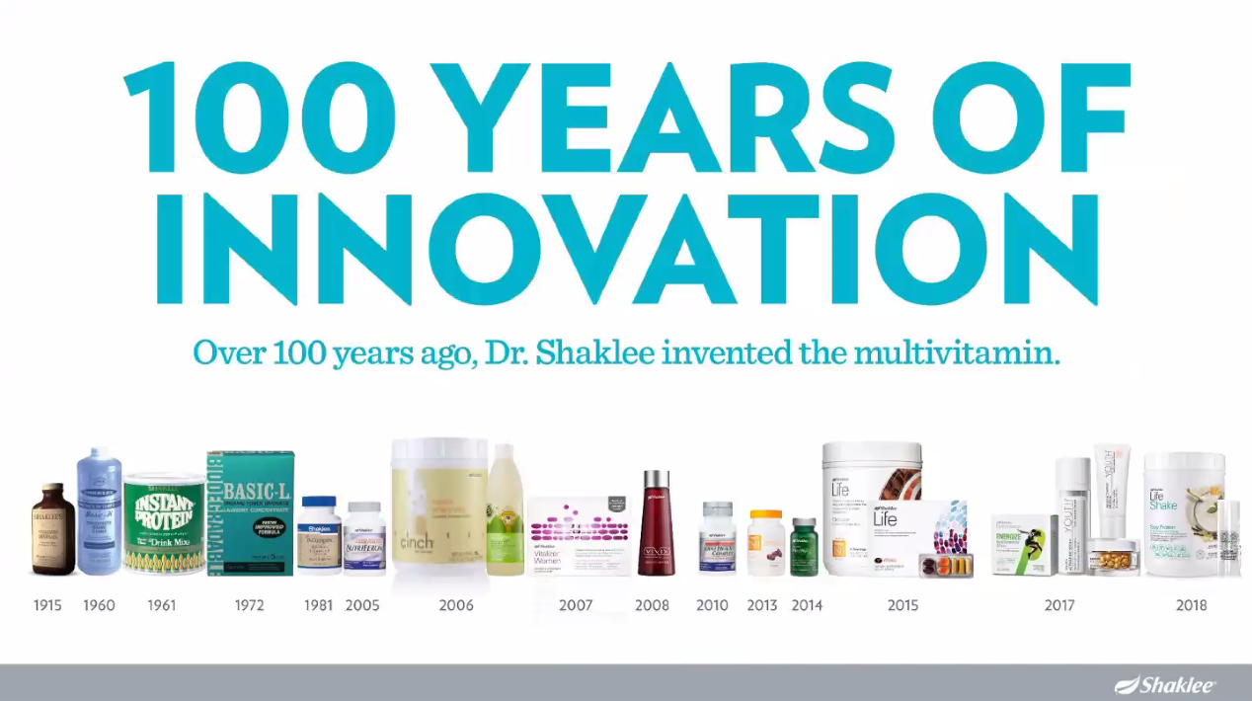
3. The Perfect PRODUCTS
100 YEARS OF
INNOVATION
Over 100 years ago, Dr. Shaklee invented the multivitamin

Slide 25

PRODUCTS in harmony with nature and good health

Slide 26

THE LANDMARK STUDY – one of a kind study on LONG TERM SUPPLEMENT USERS

Slide 27
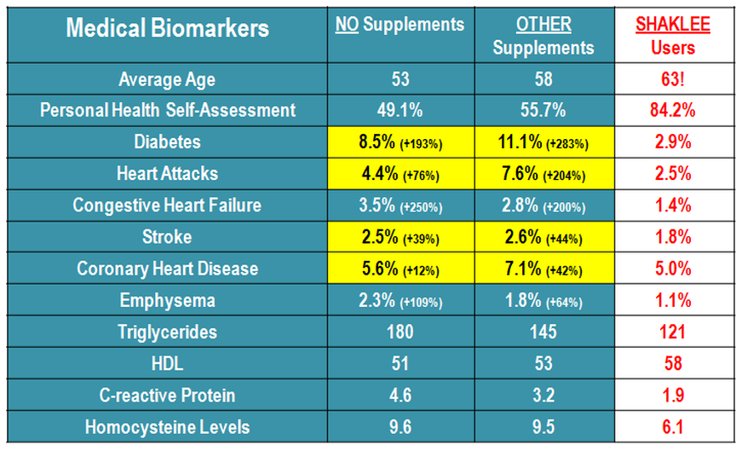





THE LANDMARK STUDY – one of a kind study on LONG TERM SUPPLEMENT USERS

Slide 28



Slide 29


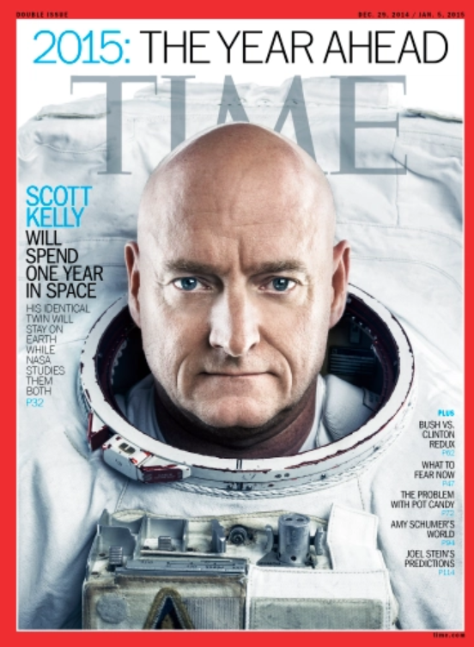
Proven by Extraordinary People

Slide 30
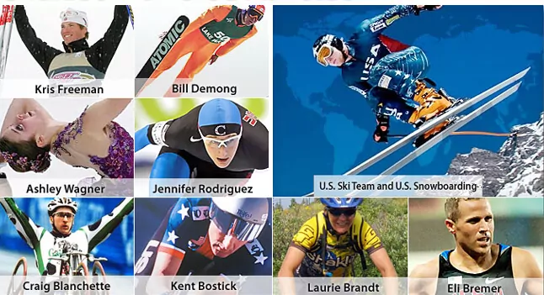
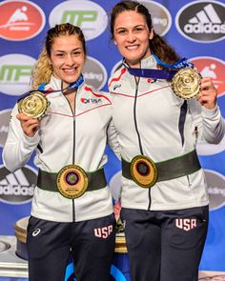
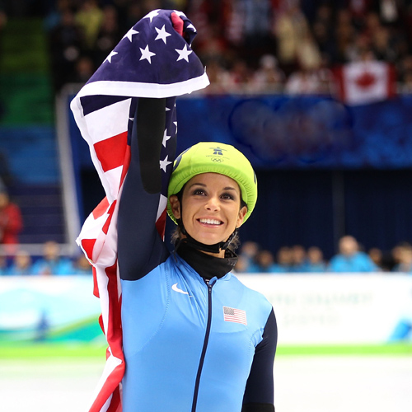

Proven by Extraordinary
People

Slide 31


Products that are GUARANTEED
BETTER HEALTH in 30 days

Slide 32


Wellness Assessment
Improve Your Health In 30 Days

Slide 33
4. SDFG* - The Perfect TEAM
Be Part of a Dynamic Team
Enjoy Great Support
Receive Proven Training
Work with LEADERS Who Are COMMITTED to
Helping YOU Achieve YOUR DREAMS
*SDFG – Shaklee Dynamic Family Global`

Slide 34
Your Next Steps
Health Assessment – See how the Shaklee Products can help you!
Follow Up – Sign up as a distributor, place your first order, and set first meeting with upline leader
New Business Leader Orientation – Join us to ensure you start off on the right foot!

Slide 35
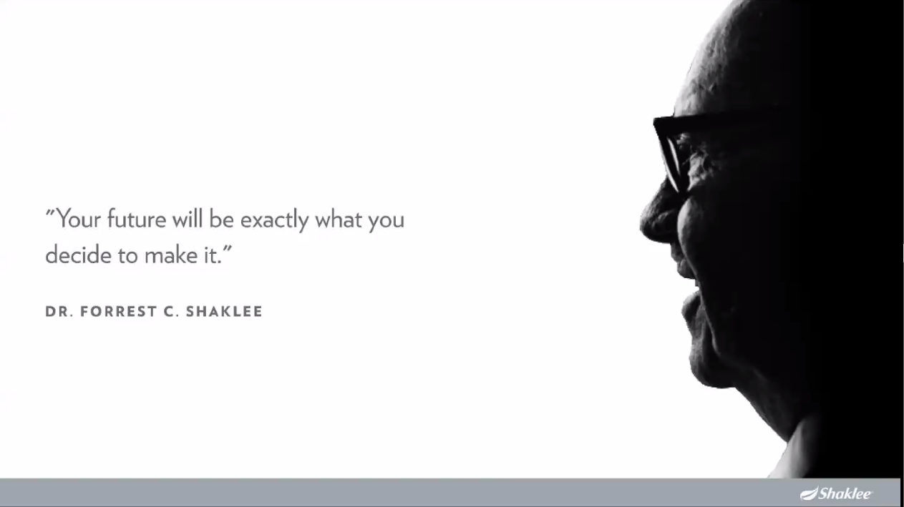
“YOUR FUTURE WILL BE EXACTLY WHAT YOU DECIDE TO MAKE IT.”
DR. FORREST C. SHAKLEE

